Slide 1
Chapter No. 3
Unicast & Multicast Routing Protocols
(14 Marks)

Slide 2
Contents
3.1 Introduction: Inter-Domain, Intra-Domain Routing
3.2 Routing Algorithms: Distance Vector Routing, Bellman-Ford Algorithm, Link State Routing, Path Vector Routing.
3.3 Unicast Routing Protocols: Internet Structure, Routing Information Protocol(RIP), Open Shortest Path First(OSPF), Border Gateway Protocol Version 4(BGP4).
3.4 Introduction: Unicast, Multicast & Broadcast.
3.5 Intra Domain Multicast Protocols: Multicast Distance Vector(DVMRP), Multicast Link State (MOSPF), Protocol Independent Multicast(PIM)

Slide 3
Introduction
An internet is a combination of networks connected by routers.
Communication in the internet today is not only unicasting, multicasting communication is growing fast.
When a datagram goes from source to destination, it will probably pass through many routers until it reaches the router attached to the destination network.
In unicasting, there is one source & one Destination network.(One To One relationship)
In multicasting, There is one to source & a group of destinations.(One to Many Relationship)

Slide 4
Introduction
When a device has multiple paths to reach a destination, it always selects one path by preferring it over others. This selection process is termed as routing.
Routing is deciding the routes that packets travel in network.
Routing is done by special network devices called routers it can be done by means of software processes.
Routing is process of establishing the routes that data packets must follow to reach the destination.
Router receives a packet from a network & passes it to another network.
In routing a routing table is created which contains information regarding routes which data packets follow.

Slide 5
Introduction
A routing table can be either static routing table or dynamic routing table.
Static routing table is one with manual entries while dynamic routing table is one that is updated automatically when there is change somewhere in the internet.
Today an internet needs dynamic routing tables.

Slide 6
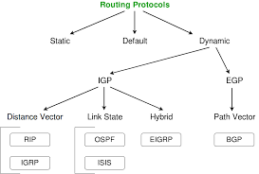
Introduction

Slide 7
Popular Routing Protocols
Routing Protocols
Intra-Domain
Inter-Domain
Distance Vector
Link
State
Path
Vector
RIP
OSPF
BGP

Slide 8
2.1 Intra & Interdomain Routing
Today, an internet can be so large that one routing cannot handle the task of updating the routing tables of all routers.
For this reason, an internet is divided into autonomous systems.
An autonomous (AS) is a group of networks & routers under the authority of single administration.
Routing inside an autonomous system is referred to as intradomain routing.
Routing between autonomous systems is referred to as interdomain routing.

Slide 9
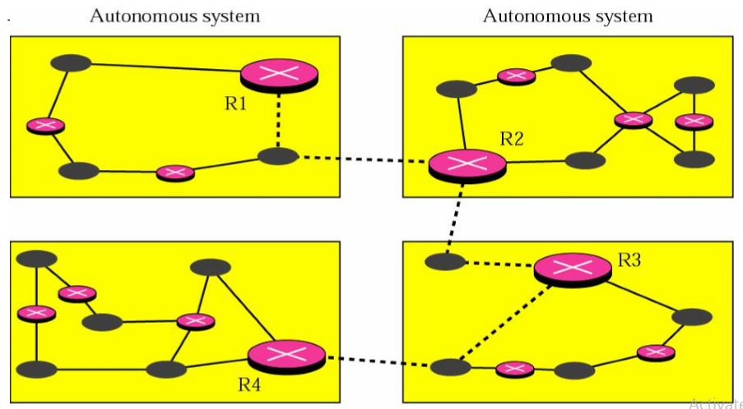
Intra & Interdomain Routing
Autonomous System

Slide 10
Intra & Interdomain Routing
Example:-
R1, R2, R3 and R4 use an Intradomain or interior and an Interdomain or exterior routing protocol.
Solid thin lines
- Interior routing protocol
Broken thick lines
- Exterior routing protocol

Slide 11
Differences between
Intra & Interdomain Routing
S. NO. | INTRADOMAIN ROUTING | INTERDOMAIN ROUTING
1. | Routing algorithm works only within domains. | Routing algorithm works within and between domains.
2. | It need to know only about other routers within their domain. | It need to know only about other routers within and between their domain.
3. | Protocols used in intradomain routing are known as Interior-gateway protocols. | Protocols used in interdomain routing are known as Exterior-gateway protocols.
4. | In this Routing, routing takes place within an autonomous network. | In this Routing, routing takes place between the autonomous networks.

Slide 12
Differences between
Intra & Interdomain Routing
S. NO | INTRADOMAIN ROUTING | INTERDOMAIN ROUTING
5. | Intradomain routing protocols ignores the internet outside the AS(autonomous system). | Interdomain routing protocol assumes that the internet contains the collection of interconnected AS(autonomous systems).
6. | Some Popular Protocols of this routing are RIP(resource information protocol) and OSPF(open shortest path first). | Popular Protocols of this routing is BGP(Border Gateway Protocol) used to connect two or more AS(autonomous system).

Slide 13
Types of routing
Static vs. Dynamic Routing
Routing is a process which is performed by layer 3 (or network layer) devices in order to deliver the packet by choosing an optimal path from one network to another.
There are 3 types of routing:
1. Static routing (Non-Adaptive) –
A static routing table is created, maintained, and updated by a network administrator, manually.
A static route to every network must be configured on every router for full connectivity.
This provides a granular level of control over routing, but quickly becomes impractical on large networks.

Slide 14
Types of routing
Static vs. Dynamic Routing
Advantages –
No routing overhead for router CPU which means a cheaper router can be used to do routing.
It adds security because only administrator can allow routing to particular networks only.
No bandwidth usage between routers.
Disadvantage –
For a large network, it is a hectic task for administrator to manually add each route for the network in the routing table on each router.
The administrator should have good knowledge of the topology. If a new administrator comes, then he has to manually add each route so he should have very good knowledge of the routes of the topology.

Slide 15
Types of routing
Static vs. Dynamic Routing
2. Default routing –
This is the method where the router is configured to send all packets towards a single router (next hop).
It doesn’t matter to which network the packet belongs, it is forwarded out to router which is configured for default routing.
It is generally used with stub routers. A stub router is a router which has only one route to reach all other networks.

Slide 16
Types of routing
Static vs. Dynamic Routing
3. Dynamic routing –
A dynamic routing table is created, maintained, and updated by a routing protocol running on the router.
Dynamic routing makes automatic adjustment of the routes according to the current state of the route in the routing table.
Dynamic routing uses protocols to discover network destinations and the routes to reach it.
RIP and OSPF are the best examples of dynamic routing protocol.
Automatic adjustment will be made to reach the network destination if one route goes down.

Slide 17
Types of routing
Static vs. Dynamic Routing
Advantages –
Easy to configure.
More effective at selecting the best route to a destination remote network and also for discovering remote network.
Disadvantage –
Consumes more bandwidth for communicating with other neighbors.
Less secure than static routing.

Slide 18
Distance Vector Routing
Distance vector routing algorithm is the dynamic routing algorithm in computer networks.
It is also known as Bellman-Ford routing algorithm to find the shortest path between nodes in a graph given the distance between nodes.
In distance vector routing, the least cost route between any two nodes is the route with minimum distance.
In this protocol, as the name implies, each node maintains a vector(table) of minimum distances to every node.
The table at each node also guides the packets to the desired node by showing the next stop in the route (Next-hop-routing).

Slide 19
Distance Vector Routing
Each node knows how to reach any other node and the cost. At the beginning, however, this is not the case the distance between itself and its immediate neighbors, those directly connected to it.
We can think of nodes as the cities in an area & the lines as the roads connecting them.
A table can show a tourist the minimum distance between cities.

Slide 20
Distance Vector Routing
a) The least-cost route between any two nodes is the route with minimum distance.
b) Each node maintains a vector(table) of minimum distances to every node.
c) The table at each node also guides the packets to the desired node by showing the showing the next hop routing.
Example:
  Assume each node as the cities.
  Lines as the roads connecting them.

Slide 21
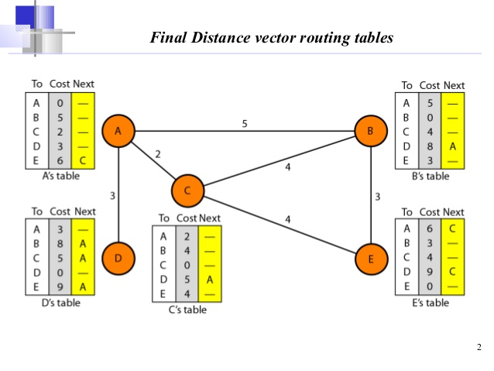
Distance Vector Routing
Distance vector routing tables
The table for A node shows how we can reach any node from this node.
Example:- Our least cost to reach node E is 6. the route passes through C.

Slide 22
Distance Vector Routing
Initialization
a) The table in figure are stable.
b) Each node knows how to reach any other node and their cost.
c) At the beginning, each node know the cost of itself and its immediate neighbor.[those node directly connected to it.]
d) Assume that each node send a message to the immediate neighbors and find the distance between itself and these neighbors.
e) The distance of any entry that is not a neighbor is marked as infinite(unreachable).

Slide 23
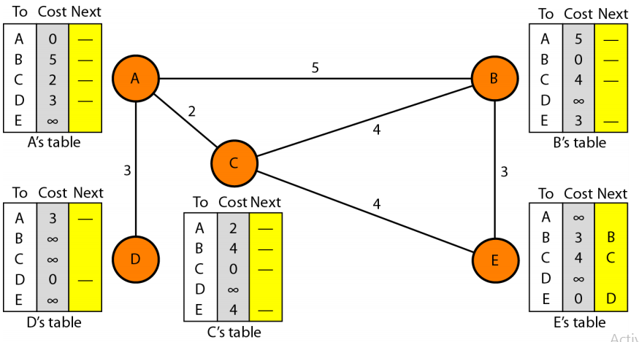
Distance Vector Routing
Initialization of tables in distance vector routing (DVR)

Slide 24
Distance Vector Routing
Sharing
a) Idea is to share the information between neighbors.
b) The node A does not know the distance about E, but node C does.
c) If node C share it routing table with A, node A can also know how to reach node E.
d) On the other hand, node C does not know how to reach node D, but node A does.
e) If node A share its routing table with C, then node C can also know how to reach node D.
f) Node A and C are immediate neighbors, can improve their routing tables if they help each other.

Slide 25
Distance Vector Routing
Updating
When a node receives a two-column table from a neighbor, it needs to update its routing table. Updating takes three steps:
1. The receiving node needs to add the cost itself and the sending node to each value in the second column.
2. The receiving node needs to add the name of the sending node to each row as the third column if the receiving node uses information from any row. The sending node is the next node in the route.
3. The receiving node needs to compare each row of its old table with the corresponding row of the modified version of the received table.

Slide 26
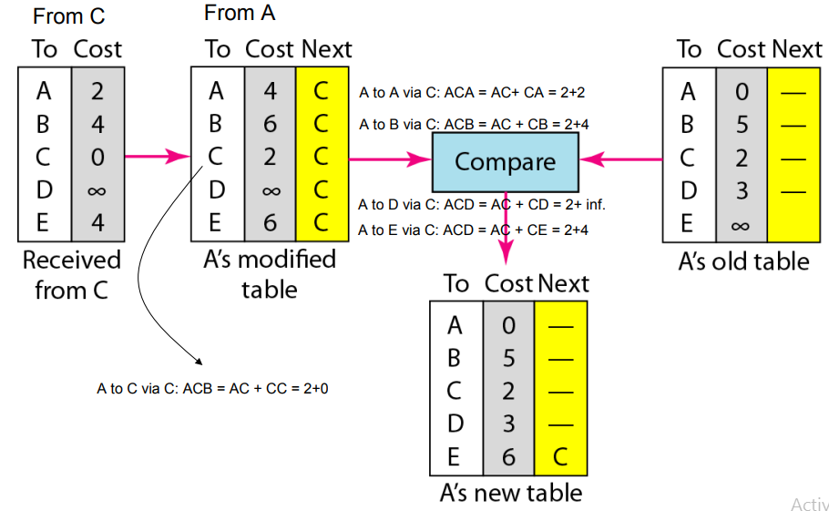
Distance Vector Routing
Updating in distance vector routing example: C to A

Slide 27
Distance Vector Routing
Advantages of DVR:-
Distance Vector is a relatively simple approach and easy to use, implement and maintain and does not require High-level knowledge to deploy.
It does not demand high bandwidth level to send their periodic updates as the size of the packets are relatively small.
Distance vector protocols do not require a large amount of CPU resources or memory to store the routing data.
Disadvantages:-
The main drawbacks of Distance Vector are limited scalability due to slow convergence time, bandwidth consumption and routing loops.
Another problem with distance vector routing is instability, which means that a network using this protocol can become unstable.

Slide 28
Example-DVR
Distance Vector Routing Algorithm-
It works in the following steps-
Step-01:
Each router prepares its routing table. By their local knowledge. each router knows about-
All the routers present in the network
Distance to its neighboring routers
Step-02:
Each router exchanges its distance vector with its neighboring routers.
Each router prepares a new routing table using the distance vectors it has obtained from its neighbors.
This step is repeated for (n-2) times if there are n routers in the network.
After this, routing tables converge / become stable.

Slide 29
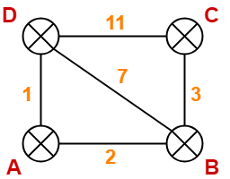
Example-DVR
Consider-
There is a network consisting of 4 routers.
The weights are mentioned on the edges.
Weights could be distances or costs or delays.

Slide 30
Example-DVR
Step-01:
Each router prepares its routing table using its local knowledge.
Routing table prepared by each router is shown below-
D’s Table
C’s Table
Destination | Distance | Next Hop
A | 1 | A
B | 7 | B
C | 11 | C
D | 0 | D
Destination | Distance | Next Hop
A | ∞ | –
B | 3 | B
C | 0 | C
D | 11 | D
A’s Table
B’s Table
Destination | Distance | Next Hop
A | 0 | A
B | 2 | B
C | ∞ | –
D | 1 | D
Destination | Distance | Next Hop
A | 2 | A
B | 0 | B
C | 3 | C
D | 7 | D

Slide 31
Example-DVR
Step-02:
Each router exchanges its distance vector obtained in Step-01 with its neighbors.
After exchanging the distance vectors, each router prepares a new routing table.
This is shown below-
At Router A-
Router A receives distance vectors from its neighbors B and D.
Router A prepares a new routing table as-
Cost of reaching destination B from
router A = min { 2+0 , 1+7 } = 2 via B.
Cost of reaching destination C from
router A = min { 2+3 , 1+11 } = 5 via B.
Cost of reaching destination D from
router A = min { 2+7 , 1+0 } = 1 via D.

Slide 32
Example-DVR
Thus, the new routing table at router A is-
Destination | Distance | Next Hop
A | 0 | A
B | 2 | B
C | 5 | B
D | 1 | D
Similarly consider router B,

Slide 33
Example-DVR
Thus, the new routing table at router A,B,C & D is-
Router D
Destination | Distance | Next Hop
A | 1 | A
B | 3 | A
C | 6 | A
D | 0 | D
Router C
Destination | Distance | Next Hop
A | 5 | B
B | 3 | B
C | 0 | C
D | 6 | B
Router A
Destination | Distance | Next Hop
A | 0 | A
B | 2 | B
C | 5 | B
D | 1 | D
Router B
Destination | Distance | Next Hop
A | 2 | A
B | 0 | B
C | 3 | C
D | 3 | A

Slide 34
Link State Routing
Link-state routing protocols are one of the two main classes of routing protocols used in packet switching networks for computer communications.
Examples of link-state routing protocols include Open Shortest Path First (OSPF) and Intermediate System to Intermediate System (IS-IS).
The link-state protocol is performed by every switching node in the network (i.e., nodes that are prepared to forward packets; in the Internet, these are called routers).
The basic concept of link-state routing is that every node constructs a map of the connectivity to the network, in the form of a graph, showing which nodes are connected to which other nodes.
Each node then independently calculates the next best logical path from it to every possible destination in the network. Each collection of best paths will then form each node's routing table.

Slide 35
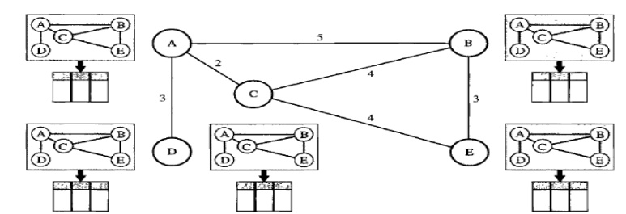
Link State Routing
Fig. Concept of Link state routing

Slide 36
Link State Routing
The figure shows a simple domain with five nodes.
Each node uses the same topology to create a routing table, but the routing table for each node is unique because the calculations based on different interpretations of the topology.
This is analogous to a city map. Different persons may have the same map, but each needs to take a different route to reach destination.
The topology must be dynamic, representing the latest situation of each node & each link.
If there are changes in any point in the network the topology must be updated for each node.

Slide 37
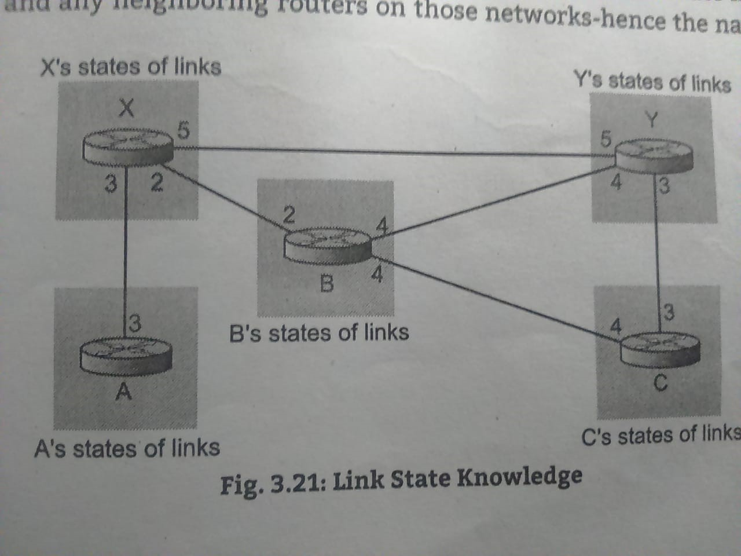
Link State Routing
Fig. Concept of Link state routing

Slide 38
Link State Routing
Shortest path first algorithm (Dijkstra algorithm) –
A calculation performed on the database results into shortest path.
Calculation of shortest path tree –
To find shortest path, each node need to run the famous Dijkstra algorithm. This famous algorithm uses the following steps:
Step-1: The node is taken and chosen as a root node of the tree, this creates the tree with a single node, and now set the total cost of each node to some value based on the information in Link State Database.

Slide 39
Link State Routing
Step-2: Now the node selects one node, among all the nodes not in the tree like structure, which is nearest to the root, and adds this to the tree. The shape of the tree gets changed .
Step-3: After this node is added to the tree, the cost of all the nodes not in the tree needs to be updated because the paths may have been changed.
Step-4: The node repeats the Step 2. and Step 3. until all the nodes are added in the tree.
Example:-1

Slide 40
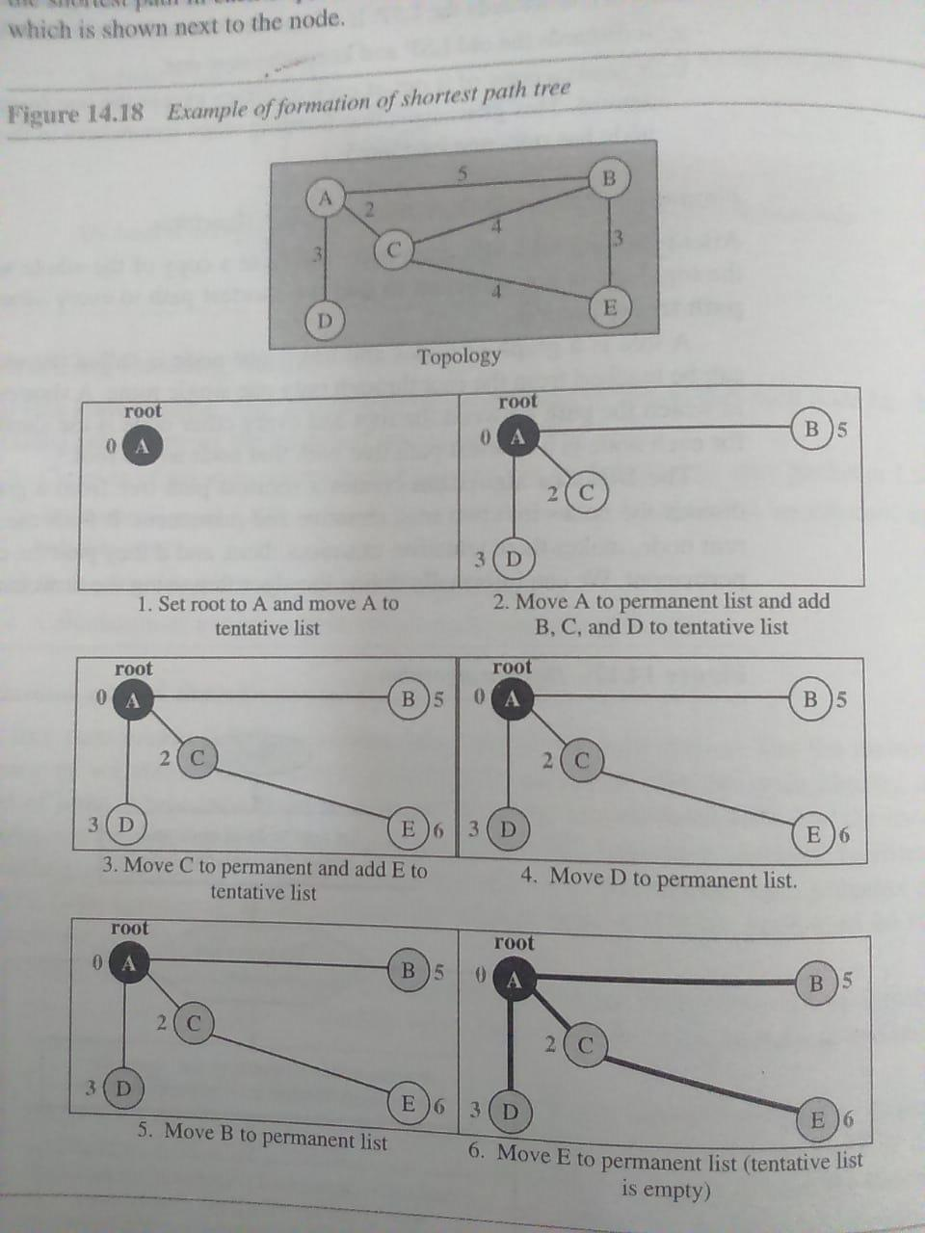
Link State Routing

Slide 41
Link State Routing
The following shows the steps. At the end of each step, we show the permanent (filled circles) & the tentative (Open circles) nodes & lists with the cumulative costs.
1.We make node A the root of the tree & move it to tentative list.
2.Node A has the shortest cumulative cost from all nodes in the tentative list. We move A to permanent list & add all neighbors of A to the tentative list.
3.Node C has the shortest cumulative cost from all nodes in the tentative list. We move C to permanent list & add neighbors to the tentative list.
Permanent List: empty Tentative List: A(0)
Permanent List: A(0) Tentative List: B(5),C(2),D(3)
Permanent List: A(0),C(2) Tentative List: B(5),D(3),E(6)

Slide 42
Link State Routing
4.Node D has the shortest cumulative cost out of all the nodes in the tentative list. We move D to permanent list. Node D has no unprocessed neighbor to be added to the tentative list.
5.Node B has the shortest cumulative cost out of all the nodes in the tentative list. We move B to the permanent list.
6.Node E has the shortest cumulative cost from all the nodes in the tentative list. We move B to the permanent list. Node E has no neighbor.
Permanent List: A(0),C(2), D(3) Tentative List: B(5), E(6)
Permanent List: A(0),B(5),C(2), D(3) Tentative List: E(6)
Permanent List: A(0),B(5),C(2), D(3), E(6) Tentative List:Empty

Slide 43
Link State Routing
Calculation of routing table from shortest path tree:
The routing table shows the cost of reaching each node from the root. Below table shows the routing table for node A.
Node | Cost | Next Router
A | 0 | --
B | 5 | --
C | 2 | --
D | 3 | --
E | 6 | C

Slide 44
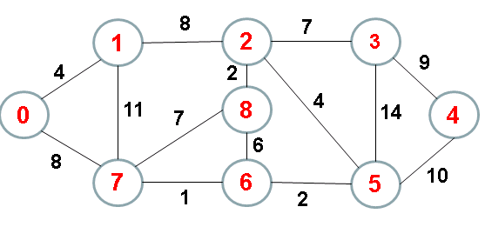
Link State Routing
Example:-2 Consider fig. Find the shortest path.

Slide 46
Path Vector Routing
Path Vector Routing is a routing algorithm in unicast routing protocol of network layer, and it is useful for inter-domain routing.
The principle of path vector routing is similar to that of distance vector routing.
It assumes that there is one node in each autonomous system that acts on behalf of the entire autonomous system is called Speaker node .
The speaker node in an AS creates a routing cable and advertises to the speaker node in the neighbouring ASs .
A speaker node advertises the path, not the metrics of the nodes, in its autonomous system or other autonomous systems.

Slide 47
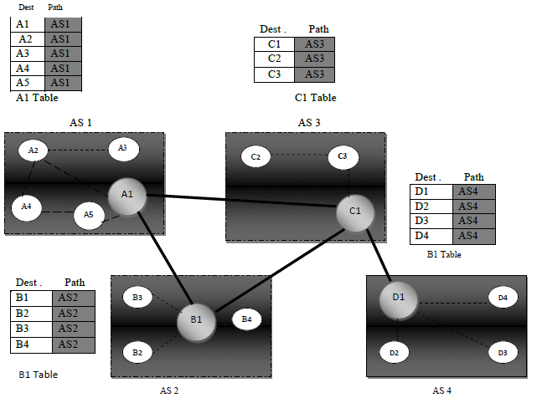
Path Vector Routing
Fig.
Initial routing tables
in path vector routine

Slide 48
Path Vector Routing
1. Initialization:-
It is the initial table for each speaker node in a system made four ASs.
Here Node A1 is the speaker node for AS1, B1 for AS2, C1 for AS3 and D1 for AS4, Node A1 creates an initial table that shows A1 to A5 and these are located in AS1, it can be reached through it.
2. Sharing:-
Just like Distance vector routing, in path vector routing, Speaker in an autonomous system shares its table with immediate neighbours ,here Node A1 share its table with nodes B1 and C1 , Node C1 share its table with nodes A1,B1 and D1 , Node B1 share its table with nodes A1 and C1 , Node D1 share its table with node C1.

Slide 49
Path Vector Routing
3. Updating:
When a speaker node receives a two-column table from a neighbor, it updates its own table by adding the nodes that are not in its routing table & adding its own autonomous system(AS) & AS that sent the table.
After a while each speaker has a table & knows how to reach each node in other AS.
Below fig. shows the tables for each speaker node after the system is stabilized.

Slide 50
Path Vector Routing
A1 Table
Dest. | Path
A1 …. A5 | AS1 …… AS1
B1 …. B4 | AS1-AS2 …… AS1-AS2
C1 …. C3 | AS1-AS3 ……. AS1-AS3
D1 …. D4 | AS1-AS3-AS4 …….. AS1-AS3-AS4
B1 Table
Dest. | Path
A1 …. A5 | AS2-AS1 …… AS2-AS1
B1 …. B4 | AS2 …… AS2
C1 …. C3 | AS2-AS3 ……. AS2-AS3
D1 …. D4 | AS2-AS3-AS4 …….. AS2-AS3-AS4
Fig. Stabilized tables for four AS

Slide 51
Path Vector Routing
C1 Table
Dest. | Path
A1 …. A5 | AS3-AS1 …… AS3-AS1
B1 …. B4 | AS3-AS2 …… AS3-AS2
C1 …. C3 | AS3 ……. AS3
D1 …. D4 | AS3-AS4 …….. AS3-AS4
D1 Table
Dest. | Path
A1 …. A5 | AS4-AS3-AS1 …… AS4-AS3-AS1
B1 …. B4 | AS4-AS3-AS2 …… AS4-AS3-AS2
C1 …. C3 | AS4-AS3 ……. AS4-AS3
D1 …. D4 | AS4 …….. AS4
Fig. Stabilized tables for four AS

Slide 52
3.3 Unicast Routing Protocols-
Internet Structure

Slide 53
Routing Information Protocols
(RIP)
RIP is an intra-domain routing protocol used inside an autonomous system.
It is a very simple protocol based on distance vector routing.
Routing Information Protocol (RIP) is a dynamic routing protocol which uses hop count as a routing metric to find the best path between the source and the destination network.
Hop Count :
Hop count is the number of routers occurring in between the source and destination network.
The path with the lowest hop count is considered as the best route to reach a network and therefore placed in the routing table.
RIP prevents routing loops by limiting the number of hopes allowed in a path from source and destination. The maximum hop count allowed for RIP is 15 and hop count of 16 is considered as network unreachable.

Slide 54
Routing Information Protocols
(RIP)
Features of RIP :
Updates of the network are exchanged periodically.
Updates (routing information) are always broadcast.
Full routing tables are sent in updates.
Routers always trust on routing information received from neighbor routers.
RIP versions :
There are three versions of routing information protocol –
RIP Version1, RIP Version2 and RIPng.
RIP v1 is known as Classful Routing Protocol because it doesn’t send information of subnet mask in its routing update.
RIP v2 is known as Classless Routing Protocol because it sends information of subnet mask in its routing update.
RIPng can only run on IPv6 networks.

Slide 55
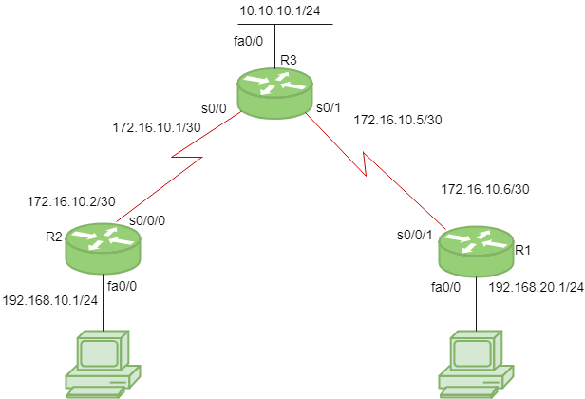
Routing Information Protocols
(RIP)
PC2
192.168.10.2/24
Fig. Configuration of RIP
PC1
192.168.20.2/24

Slide 56
Routing Information Protocols
(RIP)
Consider the above given topology which has 3-routers R1, R2, R3 & two PC’s.
Device | Interface | IP Configuration | Connected with
PC1 | Fast Ethernet | 192.168.20.2/24 | R1’s Fa0/0
R1 | fa0/0 | 192.168.20.1/24 | PC1’s Fast Ethernet
R1 | s0/0/1 | 172.16.10.6/30 | R3’s s0/1
R3 | s0/1 | 172.16.10.5/30 | R1’s s0/0/1
R3 | s0/0 | 172.16.10.1/30 | R2‘s s0/0/0
R2 | s0/0/0 | 172.16.10.2/30 | R3’s s0/0
R2 | fa0/0 | 192.168.10.1/24 | PC 2’s Fast Ethernet
PC2 | Fast Ethernet | 192.168.10.2/24 | R2’s Fa0/0

Slide 57
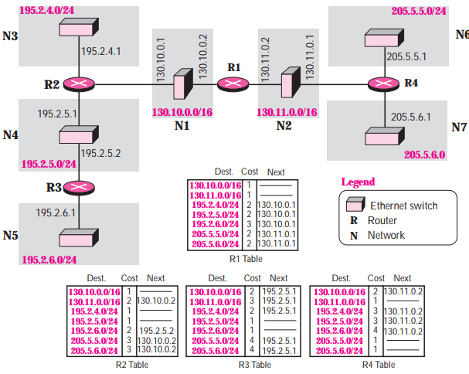
Routing Information Protocols
(RIP)

Slide 58
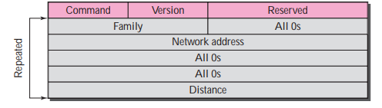
Routing Information Protocols
(RIP)
RIP Message Format
Figure. RIP message format

Slide 59
Routing Information Protocols
(RIP)
RIP Message Format
Command. This 8-bit field specifies the type of message: request (1) or response (2).
❑ Version. This 8-bit field defines the version.
❑ Family. This 16-bit field defines the family of the protocol used. For TCP/IP the value is 2.
❑ Network address. The address field defines the address of the destination network.
RIP has allocated 14 bytes for this field to be applicable to any protocol. However, IP currently uses only 4 bytes. The rest of the address is filled with 0s.
❑ Distance. This 32-bit field defines the hop count (cost) from the advertising router to the destination network.

Slide 60
Open Shortest Path First
(OSPF)
The OSPF protocol is an intra-domain routing protocol based on link state routing.
Areas
To handle routing efficiently & in timely manner, OSPF divides an AS into areas.
An Area is a collection of networks, hosts, & routers all contained within an AS.
An AS can be divided into many different areas.
All networks inside an area must be connected.
At the border of an area, special routers called area border routers summarize the information about the area and send it to other areas.
Among the areas inside an autonomous system is a special area called the backbone.

Slide 61
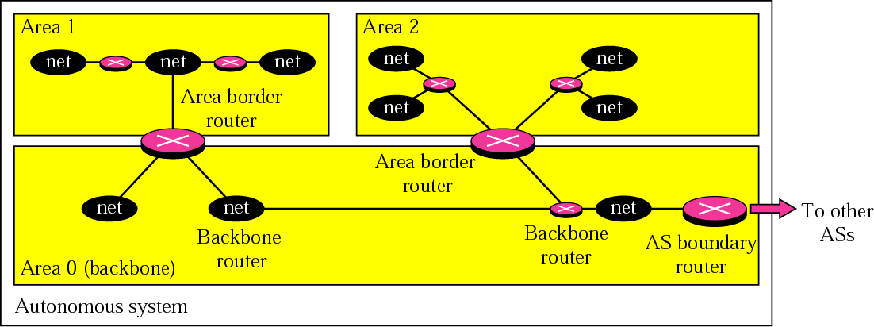
Open Shortest Path First
(OSPF)
All of the areas inside an autonomous system must be connected to the backbone.
In other words, the backbone serves as a primary area and the other areas as secondary areas.
Fig. Areas in an autonomous system

Slide 62
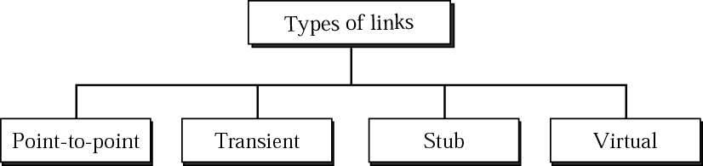
OSPF (Type of links)
In OSPF terminology, a connection is called a link.
Four types of links have been defined: point-to-point, transient, stub, and virtual

Slide 63
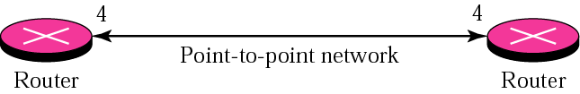
OSPF (Type of links)
1. Point-to-point:-
A point-to-point link connects two routers without any other host or router in between.
In other words, the purpose of the link (network) is just to connect the two routers.
An example of this type of link is two routers connected by a telephone line or a T-line.
There is no need to assign a network address to this type of link.

Slide 64
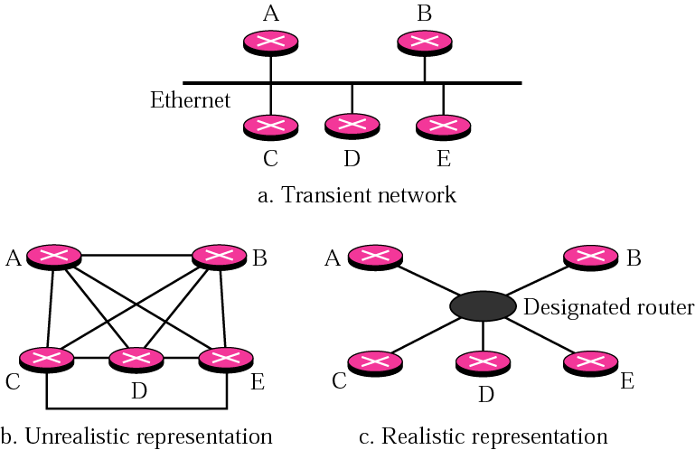
OSPF (Type of links)
2. Transient :-

Slide 65
OSPF (Type of links)
2. Transient :-
A transient link is a network with several routers attached to it.
The data can enter through any of the routers and leave through any router.
All LANs and some WANs with two or more routers are of this type.
In this case, each router has many neighbors.
For example, consider the Ethernet in Figure a. Router A has routers B, C, D, and E as neighbors. Router B has routers A, C, D, and E as neighbors.

Slide 66
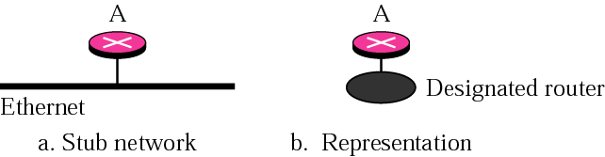
OSPF (Type of links)
3. Stub :-
A stub link is a network that is connected to only one router.
The data packets enter the network through this single router and leave the network through this same router.
4. Virtual Link
When the link between two routers is broken, the administration may create a virtual link between them using a longer path that probably goes through several routers.

Slide 67
Border Gateway Protocol (BGP)
Border Gateway Protocol (BGP) is an inter-domain routing protocol using path vector routing.
It first appeared in 1989 and has gone through four versions. (BGPv4)

Slide 68
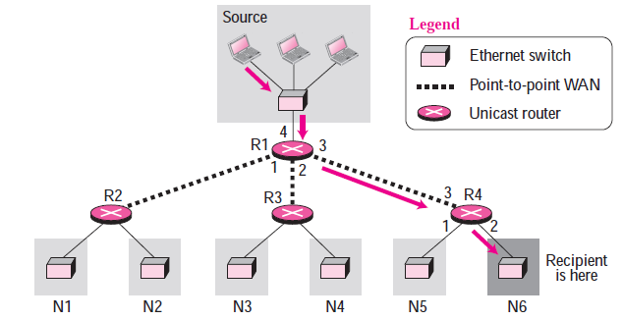
Multicasting & Multicast Routing Protocols- Unicasting
Unicasting
In unicasting, there is one source and one destination network.
The relationship between the source and the destination network is one to one.
Each router in the path of the datagram tries to forward the packet to one and only one of its interfaces.
In unicasting, the router forwards the received datagram through only one of its interfaces.

Slide 69
Multicasting & Multicast Routing Protocols- Unicasting
Figure.
shows a small internet in which a unicast packet needs to be delivered from a source computer to a destination computer attached to N6.
Router R1 is responsible to forward the packet only through interface 3; router R4 is responsible to forward the packet only through interface 2.
When the packet arrives to N6, the delivery to the destination host is the responsibility of the network; it is either broadcast to all hosts or the smart Ethernet switch delivers it only to the destination host.

Slide 70
Multicasting & Multicast Routing Protocols- Multicasting
Multicasting
In multicasting, there is one source and a group of destinations. The relationship is one to many.
In this type of communication, the source address is a unicast address, but the destination address is a group address, a group of one or more destination networks in which there is at least one member of the group that is interested in receiving the multicast datagram.

Slide 71
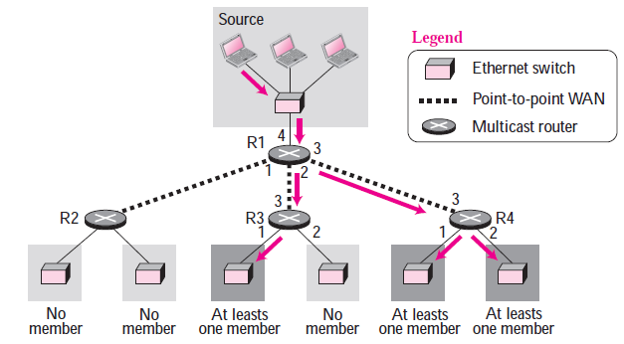
Multicasting & Multicast Routing Protocols- Multicasting
In multicasting, the router may forward the received datagram
through several of its interfaces.
In multicasting, a multicast router may have to send out copies of the same datagram through more than one interface.
In above Figure, router R1 needs to send out the datagram through interfaces 2 and 3. Similarly, router R4 also.

Slide 72
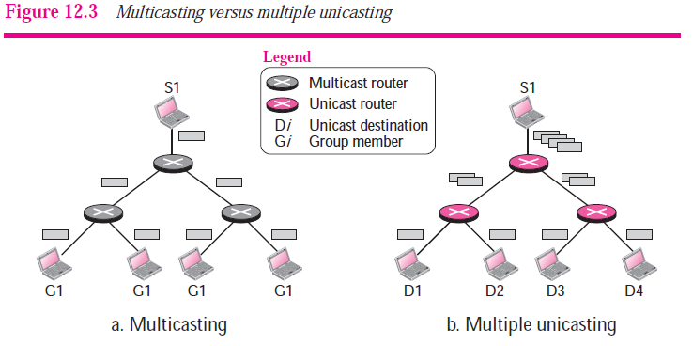
Multicasting versus Multiple Unicasting

Slide 73
Multicasting versus Multiple Unicasting
Multicasting starts with one single packet from the source that is duplicated by the routers.
The destination address in each packet is the same for all duplicates.
Note that only one single copy of the packet travels between any two routers.
In multiple unicasting, several packets start from the source. If there are four destinations, for example, the source sends four packets, each with a different unicast destination address.
Note that there may be multiple copies traveling between two routers.
For example, when a person sends an e-mail message to a group of people.

Slide 74
Multicasting & Multicast Routing Protocols- Broadcasting
In broadcast communication, the relationship between the source and the destination is one to all.
There is only one source, but all of the other hosts are the destinations.

Slide 75
Multicast Applications
Access to Distributed Databases:-
The information is stored in more than one location, usually at the time of production.
The user who needs to access the database does not know the location of the information.
A user’s request is multicast to all the database locations, and the location that has the information responds.
2. Information Dissemination:-
Businesses often need to send information to their customers.
If the nature of the information is the same for each customer, it can be multicast.
For example, a software update can be sent to all purchasers of a particular software package.

Slide 76
Multicast Applications
3. Dissemination of News:-
News can be easily disseminated through multicasting.
One single message can be sent to those interested in a particular topic.
For example, the statistics of the championship high school basketball tournament can be sent to the sports editors of many newspapers.
4. Teleconferencing:-
The individuals attending a teleconference all need to receive the same information at the same time.
5. Distance Learning:-
Lessons taught by one single professor can be received by a specific group of students.

Slide 77
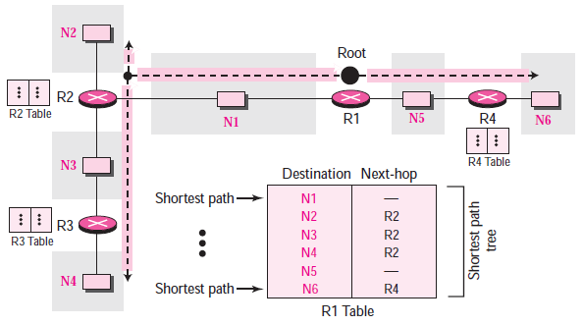
Multicast Routing
Shortest path tree in unicast routing
In unicast routing, each router in the domain has a table that defines a shortest path tree to possible destinations.

Slide 78
Multicast Routing
Shortest path tree in unicast routing
In unicast routing, when a router receives a packet to forward, it needs to find the shortest path to the destination of the packet.
The router consults its routing table for that particular destination.
The next-hop entry corresponding to the destination is the start of the shortest path.
In above figure shows the details of the routing table and the shortest path tree for router R1. Each line in the routing table corresponds to one path from the root to the corresponding network. The whole table represents the shortest path tree.

Slide 79
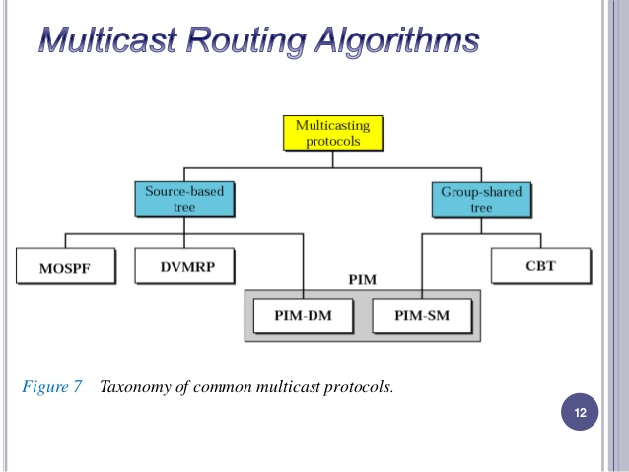
Multicast Routing

Slide 80
Multicast Routing
In multicast routing, each involved router needs to construct a shortest path tree for each group.
When a router receives a multicast packet, the situation is different. A multicast packet may have destinations in more than one network.
Forwarding of a single packet to members of a group requires a shortest path tree.
If we have n groups, we may need n shortest path trees.
We can imagine the complexity of multicast routing. Two approaches have been used to solve the problem:
1. Source-based trees
2. Group-shared trees.

Slide 81
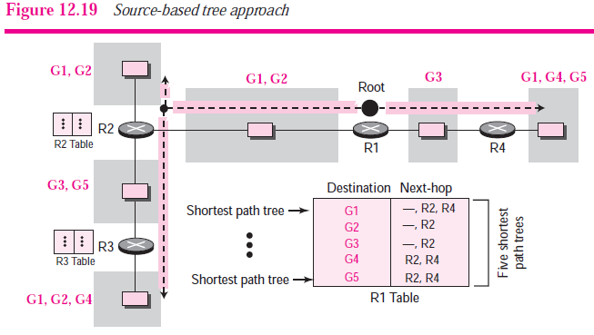
Multicast Routing- Source-Based Tree
In the source-based tree approach, each router needs to have one shortest path tree for each group.
The shortest path tree for a group defines the next hop for each network that has loyal member(s) for that group.

Slide 82
Multicast Routing- Source-Based Tree
In Figure 12.19, we assume that we have only five groups in the domain: G1, G2, G3, G4, and G5.
At the moment G1 has loyal members in four networks, G2 in three, G3 in two, G4 in two, and G5 in two. We have shown the names of the groups with loyal members on each network.
The figure also shows the multicast routing table for router R1.
There is one shortest path tree for each group; therefore there are five shortest path trees for five
Groups.
In this approach, if the number of groups is m, each router needs to have m shortest path trees, one for each group.

Slide 83
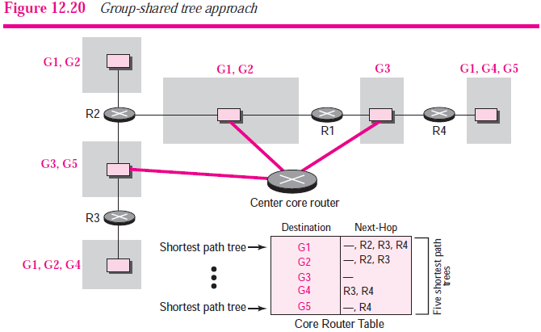
Multicast Routing- Group-Shared Tree
In the group-shared tree approach, only the core router, which has a shortest path tree for each group, is involved in multicasting.

Slide 84
Multicast Routing- Group-Shared Tree
In the group-shared tree approach, instead of each router having m shortest path trees, only one designated router, called the center core router, takes the responsibility of distributing multicast traffic.

Slide 85
Multicast Link State Routing: MOSPF
We discussed unicast link state routing in this Chapter
We said that each router creates a shortest path tree
using Dijkstra’s algorithm.
The routing table is a translation of the shortest path
tree.
Multicast link state routing is a direct extension
of unicast routing and uses a source-based tree
approach.
Although unicast routing is quite involved, the
extension to multicast routing is very simple and
straightforward.
Recall that in unicast routing, each node needs to
advertise the state of its links.
For multicast routing, a node needs to revise the
interpretation of state. A node advertises every group that
has any loyal member on the link.

Slide 86
Multicast Link State Routing: MOSPF
Multicast Open Shortest Path First (MOSPF) protocol is an
extension of the OSPF protocol that uses multicast link state
routing to create source-based trees.
The protocol requires a new link state update packet to
associate the unicast address of a host with the group
address or addresses the host is sponsoring.
This packet is called the group membership LSA (link state
advertisement)
In other words, we make a tree that contains all the hosts
belonging to a group, but we use the unicast address of the
host in the calculation.
For efficiency, the router calculates the shortest path trees on
demand (when it receives the first multicast packet).
In addition, the tree can be saved in cache memory for future
use by the same source/group pair.

Slide 87
Multicast Distance Vector
Unicast distance vector routing is very simple;
extending it to support multicast routing is complicated
Multicast routing does not allow a router to send its
routing table to its neighbors.
Multicast distance vector routing uses source-based
trees, but the router never actually makes a routing table.
When a router receives a multicast packet, it forwards the packet as though it is consulting a routing table.
We can say that the shortest path tree is evanescent.
After its use (after a packet is forwarded) the table is destroyed.
To accomplish this, the multicast distance vector algorithm uses a process based on four decision-making strategies. 1. Flooding, 2. Reverse Path Forwarding (RPF).
3. Reverse Path Broadcasting (RPB). 4. Reverse Path Multicasting (RPM).

Slide 88
Multicast Distance Vector
Four decision-making strategies.
Flooding:
Flooding is the first strategy that comes to mind. A router receives a packet and without even looking at the destination group address, sends it out from every interface except the one from which it was received.
Flooding accomplishes the first goal of multicasting: every network with active members receives the packet.
This is a broadcast, not a multicast. There is another problem: it creates loops.
The next strategy, reverse path forwarding, corrects this defect.

Slide 89
Multicast Distance Vector
2. Reverse path forwarding
Reverse path forwarding (RPF) is a modified flooding strategy.
To prevent loops, only one copy is forwarded; the other copies are dropped.
In RPF, a router forwards only the copy that has traveled the shortest path from the source to the router.
To checkout if the packet has come though its shortest path RPF uses unicast routing table.

Slide 90
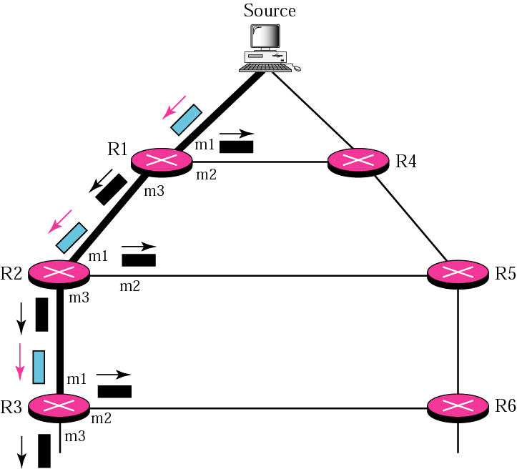
Multicast Distance Vector
The figure shows part of a domain and a source.
The shortest path tree as calculated
by routers R1, R2, and R3 is shown by a thick line.
When R1 receives a packet from the source through the interface m1, it consults its routing table and finds that
the shortest path from R1 to the source is through interface m1. The packet is forwarded.
However, if a copy of the packet has arrived through interface m2, it is discarded because m2 does not define the shortest path from R1 to the source.
The story is the same with R2 and R3.
Fig. Example of Reverse path forwarding

Slide 91
Multicast Distance Vector
3. Reverse Path Broadcasting (RPB)
RPF can eliminate loops but can not guarantee that
each network receives a single copy of a packet.
RPF guarantees that each network receives a copy of the
multicast packet without formation of loops.
However, RPF does not guarantee that each network
receives only one copy; a network may receive two or more
copies.
The reason is that RPF is not based on the destination
address (a group address); forwarding is based on the
source address.
To visualize the problem, let us look at Figure.

Slide 92
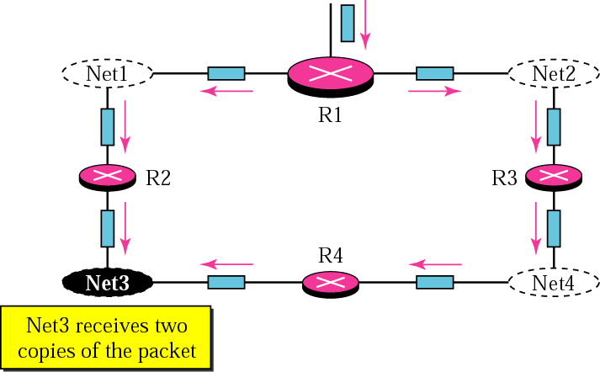
Multicast Distance Vector
3. Reverse Path Broadcasting (RPB)…(cont…)
Net3 in this figure receives two copies of the packet even though each router just sends out one copy from each interface.
There is duplication because a tree has not been made; instead of a tree we have a graph.
Net3 has two parents: routers R2
and R4.
To eliminate duplication, we must define only one parent router for each network.
Fig. Problem with RPF

Slide 93
Multicast Distance Vector
3. Reverse Path Broadcasting (RPB) (Cont..)
Now the policy is clear. For each source, the router sends the packet only out of those interfaces for which it is the designated parent. This policy is called reverse path broadcasting (RPB).
RPB guarantees that the packet reaches every network and that every network receives only one copy.
Below Figure shows the difference between RPF and RPB.

Slide 94
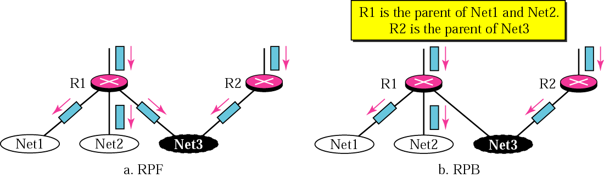
Multicast Distance Vector
3. Reverse Path Broadcasting (RPB) (Cont..)
Below Figure shows the difference between RPF and RPB.
RPB creates a shortest path broadcast tree from the source to each destination.
It guarantees that each destination receives one and only one copy of the packet.

Slide 95
Multicast Distance Vector
4. Reverse Path Multicasting (RPM)
As you may have noticed, RPB does not multicast the
packet, it broadcasts it.
This is not efficient. To increase efficiency, the
multicast packet must reach only those networks
that have active members for that particular group.
This is called reverse path multicasting (RPM).
To convert broadcasting to multicasting, the
protocol uses two procedures, pruning and grafting.

Slide 96
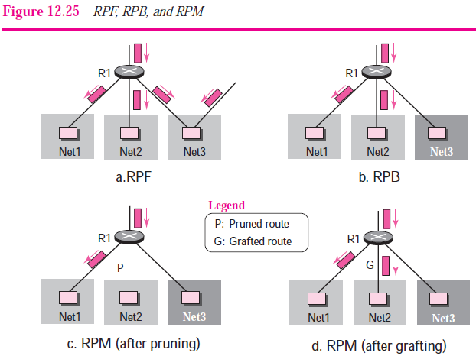
Multicast Distance Vector
4. Reverse Path Multicasting (RPM) (cont..)

Slide 97
Multicast Distance Vector
4. Reverse Path Multicasting (RPM) (cont..)
Pruning:
The process starts when a router connected to a network finds
that there is no interest in a multicast packet. The router sends
a prune message to the upstream router so that it can prune
the corresponding interface.
That is, the upstream router can stop sending multicast
messages for this group through that interface.
Grafting:
What if a leaf router (a router at the bottom of the
tree) has sent a prune message but suddenly realizes,
through IGMP, that one of its networks is again
interested in receiving the multicast packet? It can
send a graft message.
The graft message forces the upstream router to
resume sending the multicast messages.

Slide 98
Core-Based Tree (CBT)
The Core-Based Tree (CBT) protocol is a group-shared protocol that uses a core as the root of the tree.
The autonomous system is divided into regions, and a core (center router or rendezvous router) is chosen for each region.
Formation of the Tree
After the rendezvous point is selected, every router is informed of the unicast address of the selected router.
Each router with an inter created group then sends a unicast join message (similar to a grafting message) to show that it wants to join the group.
This message passes through all routers that are located between the sender and the rendezvous router.

Slide 99
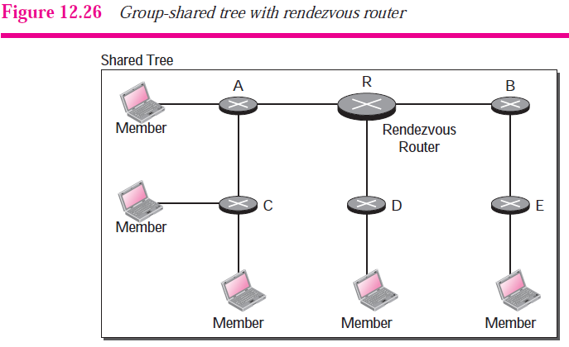
Core-Based Tree (CBT)

Slide 100
Core-Based Tree (CBT)
Sending Multicast Packets
After formation of the tree, any source (belonging to the group or not) can send a multicast packet to all members of the group.
It simply sends the packet to the rendezvous router, using the unicast address of the rendezvous router; the rendezvous router distributes the packet to all members of the group.

Slide 101
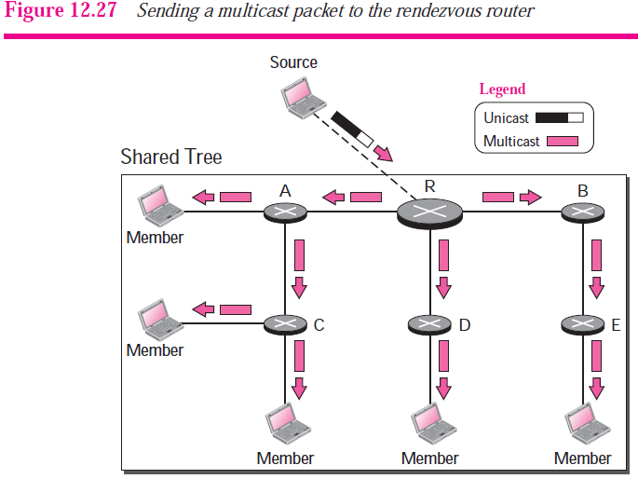
Core-Based Tree (CBT)

Slide 102
Core-Based Tree (CBT)
Advantages:
Smaller routing tables (only one entry per group).
Senders do not need to join a group to send messages.
Simple and robust (only core router maintains connectivity).
Disadvantages:
Shared trees are not as optimal as source-based trees.
Core routers can become bottlenecks.
A single point of failure.

Slide 103
Protocol Independent Multicast (PIM)
Protocol Independent Multicast (PIM) is the name given to two independent multicast
routing protocols:
1. Protocol Independent Multicast, Dense Mode (PIM-DM) and
2. Protocol Independent Multicast, Sparse Mode (PIM-SM).
Both protocols are unicast-protocol dependent,

Slide 104
Protocol Independent Multicast
Dense mode (PIM-DM):
Uses source-based trees.
PIM-DM uses RPF and pruning/grafting strategies to handle multicasting.
It is independent from the underlying unicast protocol.
Used in a dense multicast environment, such as a LAN environment.
Sparse mode (PIM-SM):
Uses shared trees.
PIM-SM is used in a sparse multicast environment such as a WAN(Wide Area Network).
PIM-SM is similar to CBT but uses a simpler procedure.

Slide 105
MBONE (Multicast Backbone)
Multimedia and real-time communication have increased the need for multicasting in the Internet.
However, only a small fraction of Internet routers are multicast routers.
In other words, a multicast router may not find another multicast router in the neighborhood to forward the multicast packet.
Solution for this problem is tunneling. We make a multicast backbone (MBONE) out of these isolated routers using the concept of tunneling.

Slide 106
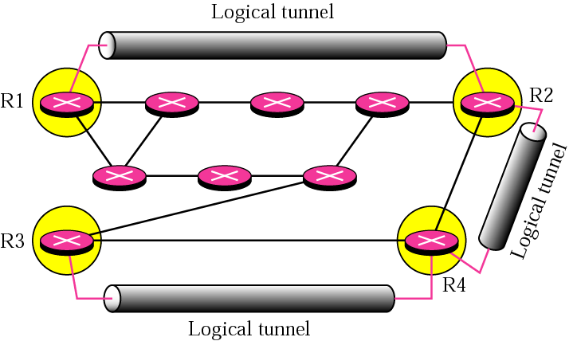
Virtual point to
point link
Isolated island of
routers
Non-multicast
routers
Fig. Logical tunneling

Slide 107
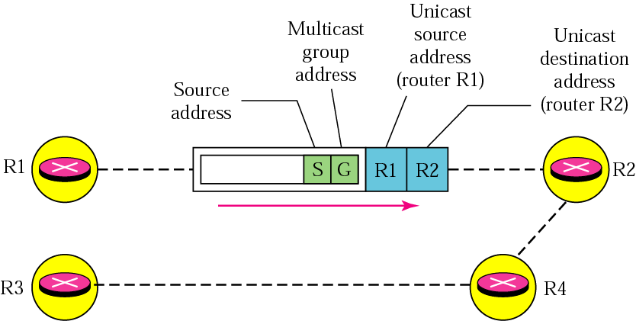
MBONE (Multicast Backbone)
A logical tunnel is established by encapsulating the multicast packet inside a unicast packet.
The multicast packet becomes the payload (data) of the unicast packet.
The intermediate (non-multicast) routers forward the packet as unicast routers and deliver the packet from one island to another.
Figure. MBONE
Payload

